Slide 1



STARTUP CANVAS
HOW TO USE?
BOOTCAMP ONE | DAY ONE
KNOWING THE STARTUPS
MAP STARTUP &
PRIORITIES
1
0
2
Problem
Note down: The top 1-3 fundamental problems for your customers/ users.
Assess: How well do you understand these problems? What is your top priority?
Start Up | Domain | Stage | Mission
Note down: The name of your startup, the domain it operates in, stage of startup journey, and mission.
Customer Segments
Write down: The profile of your customer / user segments.
Assess: How well do you understand these segments? What is your top priority?
Objective of Exercise
To create a summary of the organisations that startups can use to introduce themselves. To help startups assess their business model, and map top concerns/issues to be focused on in the program.
Tool
Startup Canvas
About ‘Startup Canvas’
The ‘Startup Canvas’ is inspired by the Lean Canvas. The canvas is useful for organisations to summarise the most important elements of their business model. The canvas is also useful as a dashboard for organisations, and to call out top concerns/issues with regards to different parts of the organisation.
Start Up | Domain | Stage | Mission:
Problem | Solution | Unique Value Proposition | Unfair Advantage | Customer Segments
 | Key Metrics |  | Channels
Cost Structure |  |  | Revenue Streams
4
5
Solution
Note down: The solutions proposed by you to these problems.
Assess: How confident are you of your solution? What is your top priority?
Channels
Note down: The paths between you and customers (inbound & outbound).
Assess: How well are your channels working? What is your top priority?
3
Unique Value Proposition
Note down: Your single, compelling message stating why you are different and worth paying attention to.
Assess: Is your Unique Value Proposition compelling?
What is your top priority?
7
6
Cost Structure
Note down: Your fixed and variable costs.
Assess: Are you comfortable about your cost structure? What is your top priority?
8
Revenue Streams
Note down: Your revenue streams.
Assess: Are you comfortable about your revenue streams? What is your top priority?
Key Metrics
Note down: The key numbers that tell you how your business is doing.
Assess: Are your key metrics working well for you? What is your top priority?
FINANCIAL INNOVATION LAB | BOOTCAMP ONE

Slide 2
BOOTCAMP ONE | DAY ONE
KNOWING THE STARTUPS
MAP STARTUP &
PRIORITIES
Notes
Session Flow
Sharing the Objective | 2 Min
Facilitators to share the objective of the session/exercise.
Walkthrough - Example | 10 Min
Facilitators to walk through 1-2 examples of the tool in use.
Walkthrough - ‘How To?’ | 10 Min
Facilitators to walk through the ‘How to?’ of the tool as per instructions on the toolsheet.
Clarifications | 8 Min
Facilitators to clarify doubts from participants.
Exercise | 60 Min
Participants to use tool with guidance from the facilitation team. A potential flow of the exercise could be -
Filling the template with details under each section - 30 Min
Mapping priorities - 20 Min
Reflecting and refining- 10 Min
Points to Consider
The numbering provided in the How To is a recommended path. Startups may still choose to fill the template as per their convenience.
The ‘problems’ section focuses on the fundamental/basic/core problems that customers face and that the startup is solving - these are not the problems the company is facing. The ‘priority’ under each section is the problem/issue for the startup with regards to that aspect.
While the ‘Unique Value Proposition’ is customer/user focused, the ‘Unfair Advantage’ is competition focused.
Startups may choose to fill the ‘Customer Segments’ section as broad segments or as specific profiles. The more specific one can get, the better.
It is possible that participants may not have a full view of their own startups and may not be able to map priorities comprehensively. A more informed view of priorities based on discussions with colleagues can be shared on day four.
Tool
Startup Canvas
Material
Template, Chart Paper, Post-Its, Pens/ Sketch Pens
Time
90 Minutes
FINANCIAL INNOVATION LAB | BOOTCAMP ONE

Slide 3
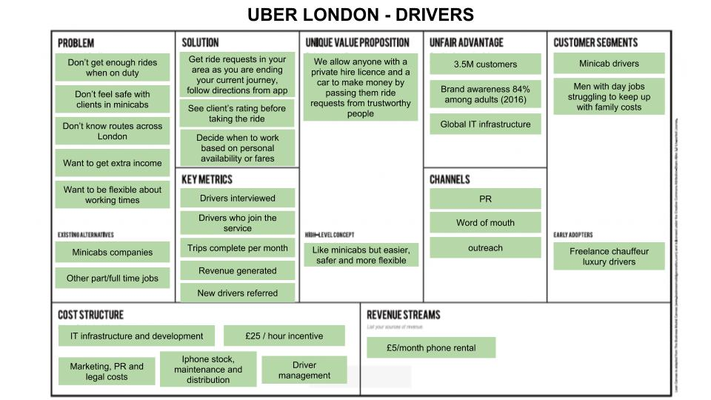
TOOL: STARTUP CANVAS
FINANCIAL INNOVATION LAB | BOOTCAMP ONE

Slide 4
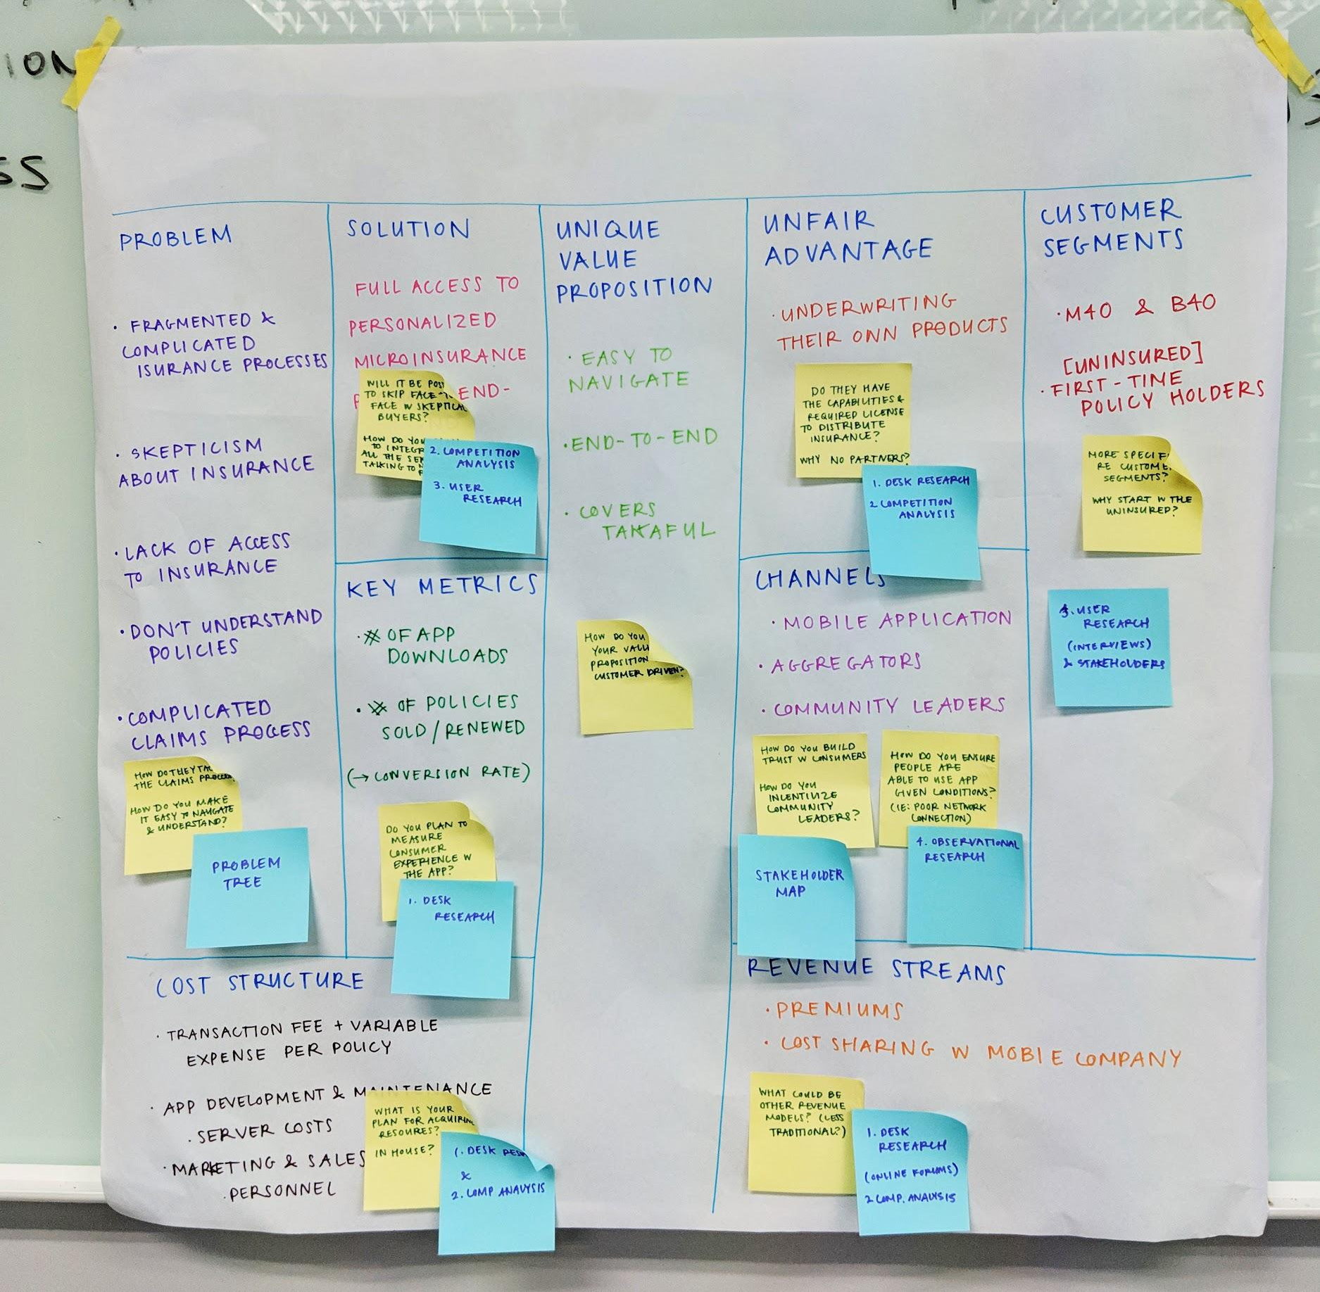
TOOL: STARTUP CANVAS
FINANCIAL INNOVATION LAB | BOOTCAMP ONE

Slide 5
TOOL: STARTUP CANVAS
Start Up: |  | Domain: |  | Stage:
Problem What are your Top 1-3 Problems for Customers/Users? | Solution What are the solutions proposed by you to these problems? | Unique Value Proposition What is your single, compelling message stating why you are different and worth paying attention to? | Unfair Advantage What is something that your have that cannot be bought or copied? | Customer Segments What is the profile of your target customers/users?
 | Key Metrics What are the key numbers that tell you how your business is doing? |  | Channels What are the paths between you and customers (inbound & outbound)?
Cost Structure What are your fixed and variable costs? |  |  | Revenue Streams What are your revenue streams?
Q: How confident are you of your solution? What is your top priority?
Q: Is your Unfair Advantage strong enough? What is your top priority?
Q: How well do you understand these problems? What is your top priority?
Q: Are your key metrics working well for you? What is your top priority?
Q: How well are your channels working? What is your top priority?
Q: How well do you understand these segments? What is your top priority?
Q: Are your comfortable about your cost structure? What is your top priority?
Q: Is your Unique Value Proposition compelling? What is your top priority?
Q: Are you comfortable about your revenue streams? What is your top priority?
FINANCIAL INNOVATION LAB | BOOTCAMP ONE

